Slide 1
Model to effectively predict factors contributing English acquisition as a second language
“A critical period for second language acquisition: Evidence from 2/3 million English speakers”
This dataset is prepared by Massachusetts Institute of Technology, Boston College and Harvard University departments of Psychology & cognitive sciences
Link to the Article: https://www.sciencedirect.com/science/article/abs/pii/S0010027718300994?via%3Dihub
Prepared by: Arsham Vosoughinia

Slide 2
Dataset Description
In a study published in 2018, three Boston-area professor analyzed data from more than 600,000 people who took an online English grammar quiz.
Participants are given a quiz graded based on a 100-percentile with respect to the number of correct answers
The quiz consists of 35 often multi-part questions
Datasets contains demographic features including age, nationality, level of education, native language , English status, etc.
The grade in this data set is presented in both percentile and logarithmic forms.

Slide 3
Projects Goals
Identifying determining social and demographic factors that impact acquisition of English as the second language
The result can be used for educational purposes with aim to maximize English learning with respect to the learner's background
Group variances among each feature are examined for explanatory purposes

Slide 4
Data Structure
Raw Data Size: 85,695,744
DataSet Shape: (669,498 , 128)
Data Types: : Numerical (Binary, Integer, Float), String Categorical
Columns:
['Unnamed: 0', 'id', 'date', 'time', 'gender', 'age', 'natlangs', 'primelangs’,'dyslexia', 'psychiatric', 'education', 'tests', 'Eng_start', 'Eng_country_yrs’,'house_Eng', 'dictionary', 'already_participated', 'countries', 'currcountry’,'US_region', 'UK_region', 'Can_region', 'Ebonics', 'Ir_region', 'UK_constituency’,'nat_Eng’,'prime_Eng', 'speaker_cat', 'type', 'Lived_Eng_per', 'Eng_little’,q1……….q35_8,‘correct’,’elogit’]

Slide 5
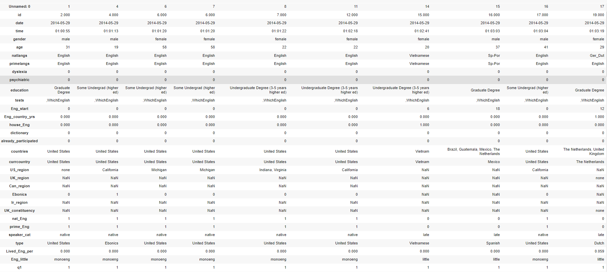
Dataset Example
A Glance at Data Set

Slide 6
Features examined/Target variable
Target variable | Description | Type
‘elogit’ | Logarithmic representation of column ‘correct’ | Float
‘correct’ | Percental grade of the test | Integer
Feature/Columns | Description | Type
‘natlangs’ | List of participant’s primary languages | Object/String
‘primelangs’ | List of subject's native languages | Object/String
‘Eng_start’ | Participant’s Age at the time of learning Start | Integer
‘prime_Eng’ | If the participant’s primary language is English | Binary
‘house_Eng’ | If the participant has lived with native speakers | Binary
‘nat_Eng’ | If the participant is a native speaker of English | Binary
‘speaker_cat’ | Participant’ level ( native, foreign, late) | String
‘age’ | Participant’s age | Integer
‘gender’ | Participant’s gender | String/Binary
‘education’ | Participant’s education level | Object/String
'Eng_country_yrs' | years living in English-speaking country | Integer
'Lived_Eng_per' | Percentage of age spent in an English speaking country | Float 0.0-1.0
'Eng_little' | monoeng (native of English only), Bilengual, lot, little | String
Type | Nationality | String

Slide 7
Data Cleaning & Modification
All the missing and improper values were dropped from the previously mentioned columns.
The value ‘other’ has been dropped in column ‘gender’.
Participants with psychiatric conditions or dyslexia have been excluded.
The languages in ‘Native Language’ and ‘Primary Language’ are grouped based on languages language families
and lexical overlap
Multiple language values for the above columns are removed if English was one of the values.
Languages with limited number of speakers are excluded (under 240 speakers)
The values in column ‘education’ have been reduced and modified to conventional and widely known educational levels.
The outliers on target variables are removed to the 95th percentile.

Slide 8
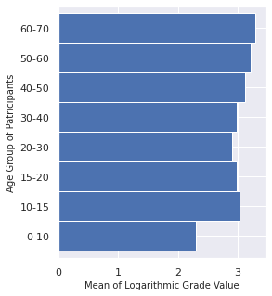
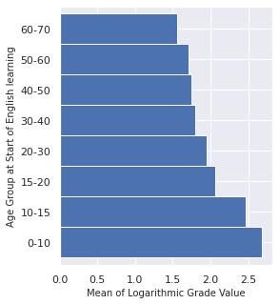
Features Representation
Age Groups Age at Start of English

Slide 9
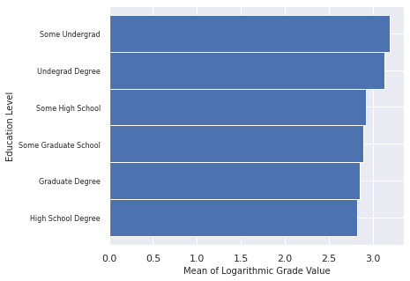
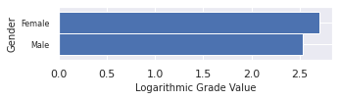
Feature Representation
Education Level
Gender difference

Slide 10
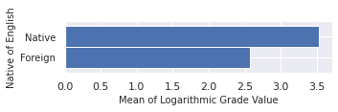
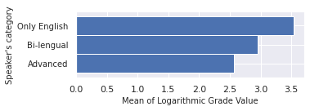
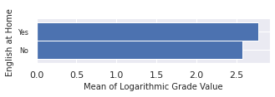
Feature Representation
Native or Foreign Speaker
Mono-lingual or Bi-Lingual or Advanced
Spoke English at Home at any point

Slide 11
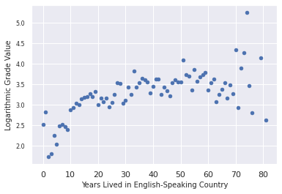
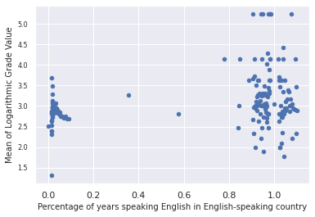
Feature Representation
Distribution by Ratio of Years Speaking English in English-Speaking Country
Distribution by Years Lived in English-Speaking Country

Slide 12
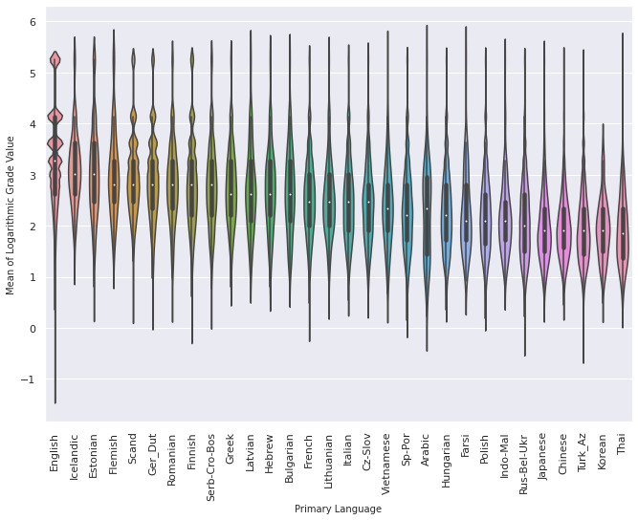
Feature Representation
Primary Languages

Slide 13
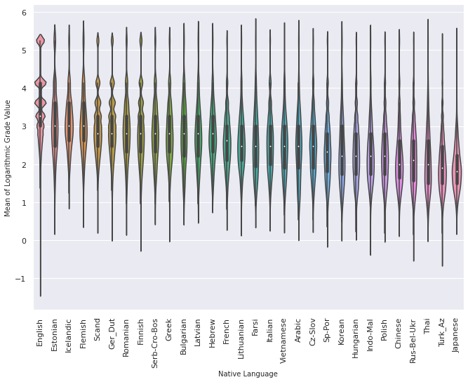
Feature Representation
Native Languages

Slide 14
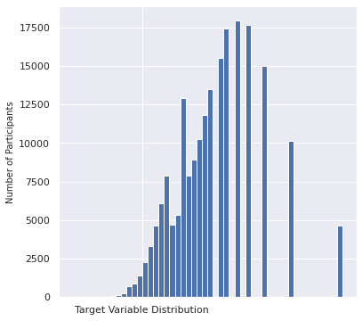
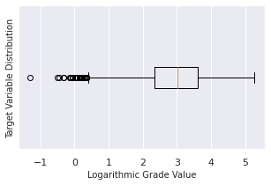
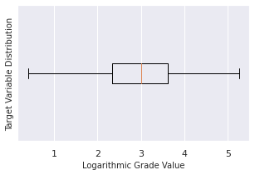
Target Variable
Target Variable Distribution
Target Variable Distribution after Removing the outliers
Mean 2.980
Stnd Dvt 1.003
Min 0.401
25% 2.332
50% 3.012
75% 3.622
Max 5.252

Slide 15
Model Selection & Details
Model used are Gradient Boosting Regression & Root Mean Square Error
Test data size is 25% of Train data
Feature Gender is transformed to a binary valued column
Features Native languages and Primary languages are transformed to binary columns based on their unique values
A new column was created subtracting age from age of start, addressing the years the participant knows English
The number of rows in the dataset changed to (351,510) after all data cleaning and feature engineering

Slide 16
Results
The GNR Model revealed R-Squared scores of 0.423 for the train set and 0.476 for the test set.
The RMS Error was 0.727 between the actual and predicted.
The above values are considered appropriate values of R-Squared and RMSE in social and human studies.
The most significant sub-features were accordingly:
Age at Start,
Years Knowing English
Age
Native of English,
Gender

Slide 17
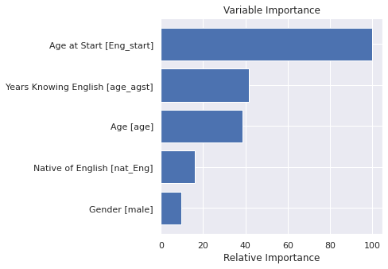
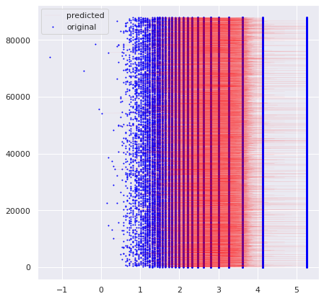
Visualizing Results

Slide 18
External Sources
Moksony, F. (1999). Small is beautiful. The use and interpretation of R2 in social research [Slides]. Academia.Edu. https://www.academia.edu/3880005/Small_is_beautiful_The_use_and_interpretation_of_R2_in_social_research
https://www.researchgate.net/post/Acceptable_ranges_of_r-Square_in_Social_Sciences

Slide 19
Thank You!

